Slide 1
Employee Data Analysis using Excel
STUDENT NAME: SIVASANKARI K
REGISTER NO: 312209356
DEPARTMENT: B.COM General
COLLEGE: Anna Adarsh College for Woman

Slide 2
PROJECT TITLE
Employee Performance Analysis using Excel

Slide 3


AGENDA
Problem Statement
Project Overview
End Users
Our Solution and Proposition
Dataset Description
Modelling Approach
Results and Discussion
Conclusion
3/21/2024 Annual Review

Slide 4

PROBLEM STATEMENT
Performance analysis is done for the organization growth and individual growth
To calculate the salary and bonus of the employee in an organization.

Slide 5

PROJECT OVERVIEW
An employee database is a structured collection of information about employees within an organization

Slide 6

WHO ARE THE END USERS?
The end users of the employment data set they are
Organization
Employer
Employee

Slide 7

OUR SOLUTION AND ITS VALUE PROPOSITION
In the employee dataset first and for most thing we I created the pivot table and using the formula to find out the performance level of the employees and then created the chart for the pivot table

Slide 8
Dataset Description
Employee dataset
Employee ID
First name
Last name
Business unit
Employment status
Employment type
Gender code
Performance level

Slide 9
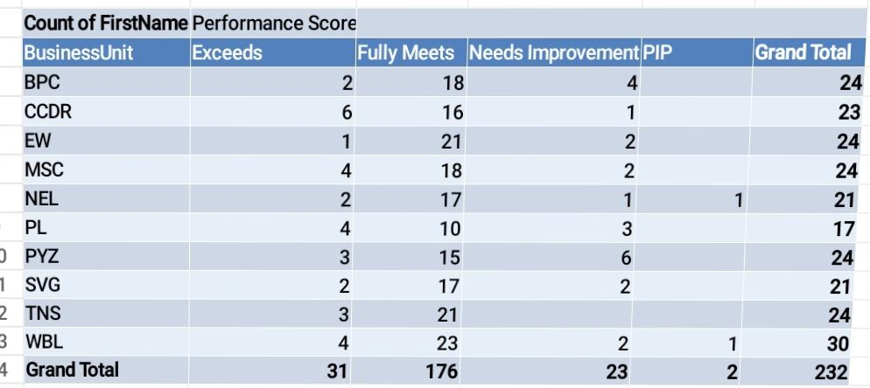

THE "WOW" IN OUR SOLUTION
3/21/2024 Annual Review
9

Slide 10
MODELLING
My Project is about the classification and representing the employee performance using pivot table and chart. The employee details are taken from the kaggle and download the excel from it. And I created the pivot table and using the pivot table created the chart for the excel.
10

Slide 11
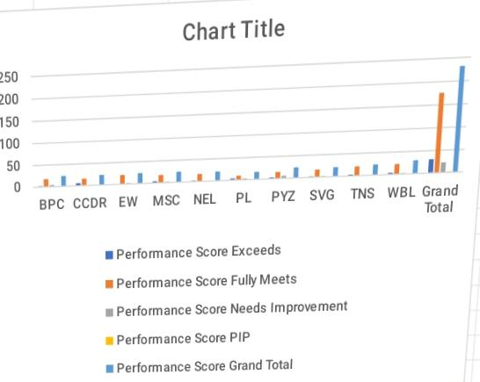
RESULTS
11

Slide 12
conclusion
We can conclude that We can use the given information is to create the pivot table in the excel and chart for the given information We can compare and give the difference to the excel and the pivot table final information. We used IF formula and IFS Formula to calculate performance level.

